Slide 1

Crafting a Temperature and Humidity Monitoring System

Slide 2

LIST OF COMPONENTS:
ESP32 MICROCONTROLLER
DHT11
LCD DISPLAY 16X2 I2C
JUMPER WIRES
BREAD BOARD

Slide 3
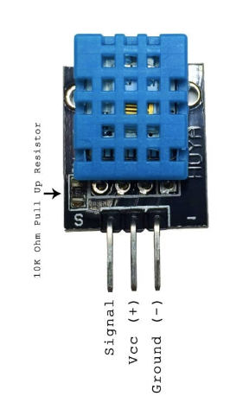
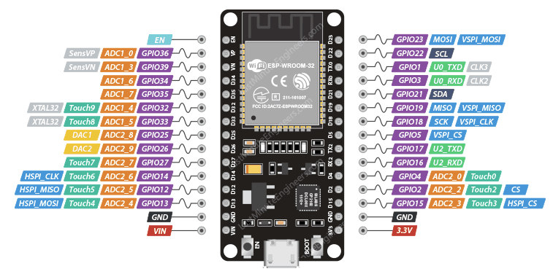
Circuit Diagram:-
3v3 VCC

Slide 4
D5------->Signal (or) Data

Slide 5
GND-------->GND

Slide 6
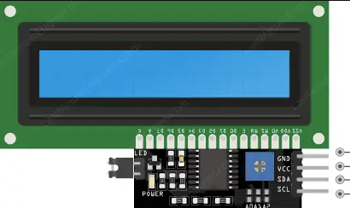
CONNECT SDA-D21

Slide 7
CONNECT SCL-D22

Slide 8
CONNECT VCC=VIN
CONNECT GND-GND

Slide 9
CONTINUE
CODE:
#include <Wire.h>
#include <LiquidCrystal_I2C.h>
#include <DHT.h>
#define DHTPIN 5
#define DHTTYPE DHT11
DHT dht(DHTPIN, DHTTYPE);
LiquidCrystal_I2C lcd(0x27, 16, 2);
void setup() {
Serial.begin(115200);
dht.begin();
lcd.init();
lcd.backlight();
lcd.setCursor(0, 0);
lcd.print("Temperature:");
lcd.setCursor(0, 1);
lcd.print("Humidity:");
}
void loop() {
delay(2000);
float temperature = dht.readTemperature();
float humidity = dht.readHumidity();
Serial.print("Temperature: ");
Serial.print(temperature);
Serial.println(" °C");
Serial.print("Humidity: ");
Serial.print(humidity);
Serial.println(" %");
lcd.setCursor(13, 0);
lcd.print(" ");
lcd.setCursor(13, 0);
lcd.print(temperature);
lcd.setCursor(11, 1);
lcd.print(" ");
lcd.setCursor(11, 1);
lcd.print(humidity);
}

Slide 10
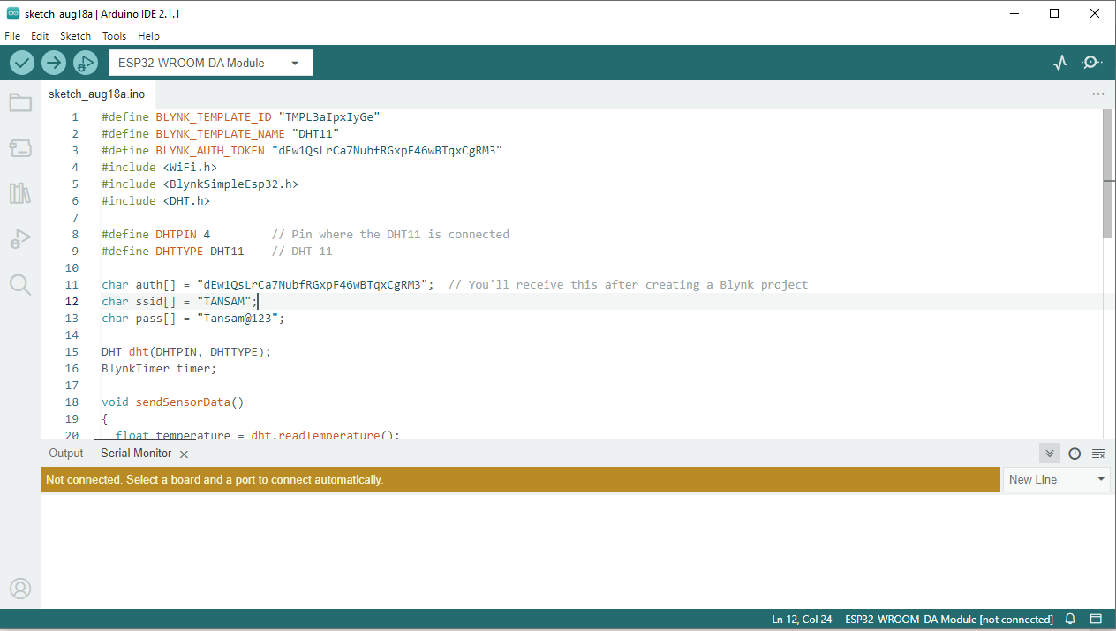
Step-1:-
Copy code paste in Arduino new Sketch

Slide 11
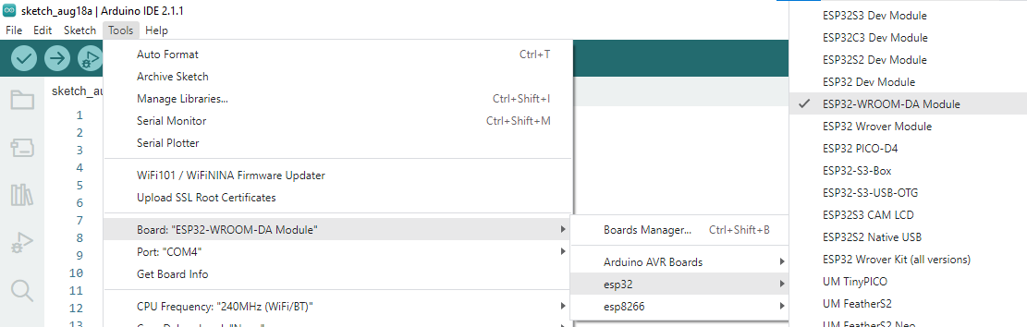
Step-2
Board---->esp32---->esp32-wroom-DA module

Slide 12
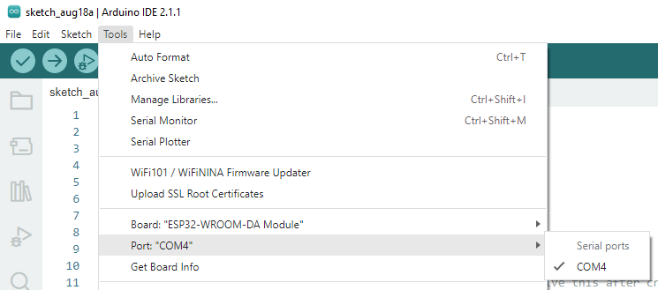
Step-3:-
Tools---->port---->select your com

Slide 13
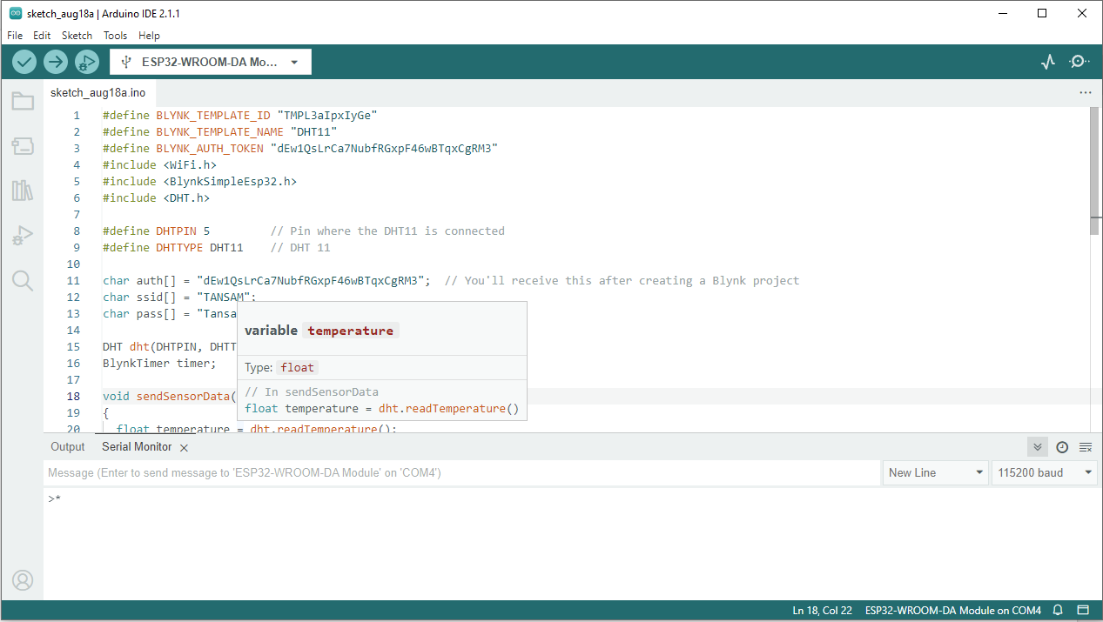
board name automatically change to dark

Slide 14
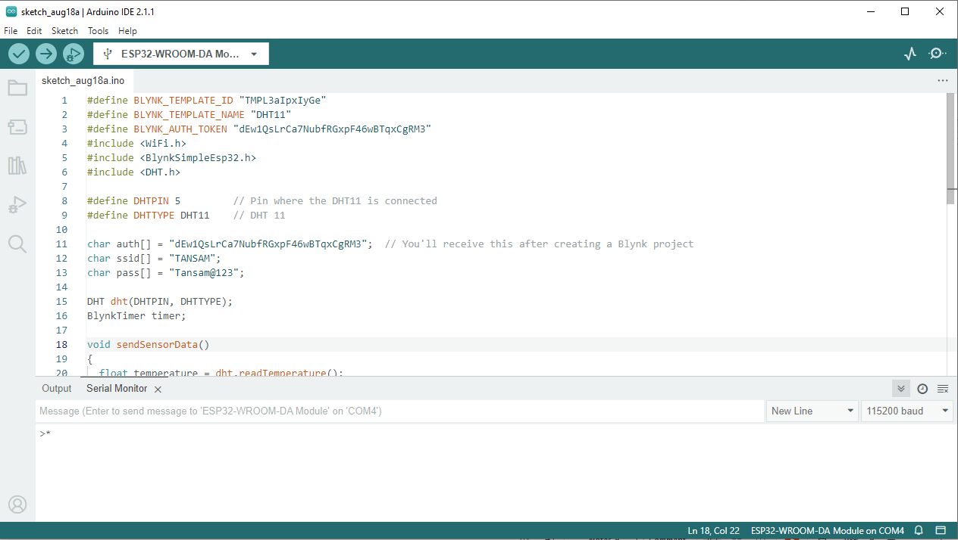
2.After Compilation build the code to board
1.Compile the code

Slide 15
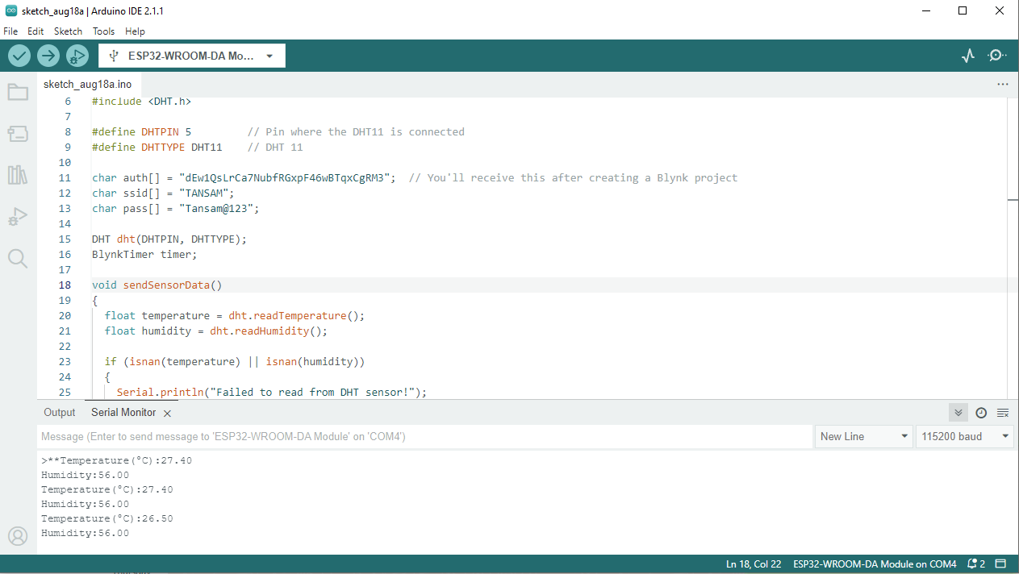
After Build the code the output like this

